Slide 1
The Longest Common Subsequence (LCS) Problem
A string : S₁ = “TAGTCACG”
A subsequence of S₁ : deleting 0 or more symbols from S₁ (not necessarily consecutive).
e.g. G, AGC, TATC, AGACG
Common subsequences of S₁ = “TAGTCACG” and S₂ = “AGACTGTC” :
GG, AGC, AGACG
Longest common subsequence (LCS) : S₁: TAGTCACG
S₂: AGACTGTC
LCS: AGACG

Slide 2
Applications of LCS
The edit distance of two strings or files.
(# of deletions and insertions)
S₁: TAGTCAC G
S₂: AG ACTGTC
Operation: DMMDDMMIMII
Spoken word recognition
Similarity of two biological sequences (DNA or protein)
Sequence alignment

Slide 3
DNA and RNA
Nucleotide ：
(adenine, A)
(guanine, G)
(cytosine, C)
(thymine, T)
(uracil, U)
DNA(deoxyribonucleic acid )
{A, G, C, T} (base pair: G≡C, A=T )
RNA(ribonucleic acid)
{A, G, C, U} (base pair: G≡C, A=U, G−U )

Slide 4
DNA Length
The total length of the human DNA is about 3×10⁹ base pairs.
1% ~ 1.5% of DNA sequence is useful.
# of human genes: 30,000~40,000
Conclusion from the Human Genome Project (1990~2003)
Expected # is 100,000 originally.

Slide 5
DNA, Genes and Proteins
DNA: program for cell processes
Proteins: execute cell processes
DNA
TCCAACGGTGCTGAGGTGCAC
Protein
Gene

Slide 6
Example: Longest Common Subsequence (LCS): Motivation
Strand of DNA: string over finite set {A,C,G,T}
each element of set is a base: adenine, guanine, cytosine or thymine
Compare DNA similarities
S₁ = ACCGGTCGAGTGCGCGGAAGCCGGCCGAA
S₂ = GTCGTTCGGAATGCCGTTGCTCTGTAAA
One measure of similarity:
find the longest string S₃ containing bases that also appear (not necessarily consecutively) in S₁ and S₂
S₃ = GTCGTCGGAAGCCGGCCGAA
source: 91.503 textbook Cormen, et al.

Slide 7
Chapter Six Backtrack search algorithm

Slide 8
Backtracking
Suppose you have to make a series of decisions, among various choices, where
You don’t have enough information to know what to choose
Each decision leads to a new set of choices
Some sequence of choices (possibly more than one) may be a solution to your problem
Backtracking is a methodical way of trying out various sequences of decisions, until you find the correct one that “works”.

Slide 9
Backtracking
Backtracking is used to solve problems in which a sequence of objects is chosen from a specified set so that the sequence satisfies some criterion.
Backtracking is a modified depth-first search of a tree.
It is the procedure whereby, after determining that a node can lead to nothing but dead nodes, we go back (“backtrack”) to the node’s parent and proceed with the search on the next child.

Slide 10
Backtrack Algorithm
Based on depth-first recursive search
Approach
Tests whether solution has been found
If found solution, return it
Else for each choice that can be made
Make that choice
Recursive
If recursion returns a solution, return it
If no choices remain, return failure
Some times called “search tree”

Slide 11
Improving Backtracking
Search pruning will help us to reduce the search space and hence get a solution faster.
The idea is to avoid those paths that may not lead to a solutions as early as possible by finding contradictions so that we can backtrack immediately without the need to build a hopeless solution vector.

Slide 12
Backtracking applications
The backtracking can be used in this cases:
Solving a maze
Coloring a map
Solving a puzzle
N queens problem etc.,

Slide 13
Backtracking EXAMPLE—8 Queens Problem
The 8-queens problem is a classical combinatorial problem in which it is required to place eight queens on an 8 x 8 chessboard so no two can attack each other.
A queen can attack another queen if it exists in the same row, column or diagonal as the queen.

Slide 14

Backtracking EXAMPLE—8 Queens Problem(cont…)
This problem can be solved by trying to place the first queen, then the second queen so that it cannot attack the first, and then the third so that it is not conflicting with previously placed queens.

Slide 15

Backtracking EXAMPLE—8 Queens Problem(cont…)
It is an empty 8 x 8 chess board. We have to place the queens in this board.

Slide 16
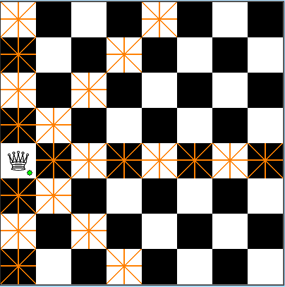
Backtracking EXAMPLE—8 Queens Problem(cont…)
We have placed the first queen on the chess board

Slide 17

Backtracking EXAMPLE—8 Queens Problem(cont…)
Then we have placed the second queen on the board.
The darken place should not have the queens because they are horizontal, vertical, diagonal to the placed queens.

Slide 18

Backtracking EXAMPLE—8 Queens Problem(cont…)
We have placed the third queen on board.

Slide 19
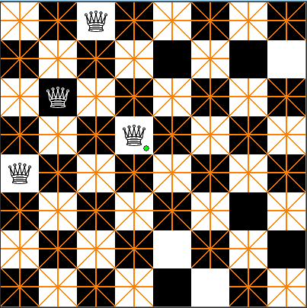
Backtracking EXAMPLE—8 Queens Problem(cont…)
We have placed the 4th queen on the board.
We have placed that in the wrong spot, so we backtrack and change the place of that one.

Slide 20

Backtracking EXAMPLE—8 Queens Problem(cont…)
In this way, we have to continue the process untill our is reached ie., we must place 8 queens on the board.

Slide 21
Backtracking EXAMPLE—8 Queens Problem(cont…)
Backtracking provides the hope to solve some problem instances of nontrivial sizes by pruning non-promising branches of the state-space tree.
The success of backtracking varies from problem to problem and from instance to instance.
Backtracking possibly generates all possible candidates in an exponentially growing state-space tree.

Slide 22
Parallelizing backtrack algorithm
First, we have to parallelize the root node of the algorithm.
Then the sub nodes and the child nodes should be parallelized independently using the other processors.
For example, if we take the 8 queens problem then it can be easily implemented in parallel.
The N-queens problem can be parallelized in this way.

Slide 23
Parallelizing backtrack algorithm
The solutions to the n-queens problem can be generated in parallel by using the master-worker technique.
The manager generates the upper portion of the search tree by generating those nodes of fixed depth d, for some d.
The manager dynamically passes each of these sequences to an idle worker, who in turn continues to search for sequences with n-queens property that contain the fixed subsequence of length d.
The master-worker technique is particularly well-suited for implementation with MPI

Slide 24
Parallelizing backtrack algorithm
Parallelizing the backtrack algorithm will gives us a good speedup and efficiency when compared to the normal algorithm.
The speedup and the efficiency will gets drastically increased when it is done in the parallel.

Slide 25

THE
BEST
NEVER
REST!

